Slide 1

6th Grade Accelerated Math
Unit 15, Lesson 7 Experimental and Theoretical Probabilities from Simulations Volume 2, pg. 431

Slide 2


Benchmarks
MA.7.DP.2.3
Find the theoretical probability of an event related to a simple experiment.
MA.7.DP.2.4
Use a simulation of a simple experiment to find experimental probabilities and compare them to theoretical probabilities.
volume 2, pg. 431

Slide 3
Integrated Mathematical Thinking and Reasoning Standards
MA.K12.MTR.1.1 Actively participate in effortful learning both individually and collectively.
MA.K12.MTR.4.1 Engage in discussions that reflect on the mathematical thinking of self and others.
MA.K12.MTR.5.1 Use patterns and structure to help understand and connect mathematical concepts.
MA.K12.MTR.7.1 Apply mathematics to real-world contexts.
volume 2, pg. 431

Slide 4

Learning Target
I can determine the probability of an event from a simulation and compare it to the theoretical probability of the event.
volume 2, pg. 431

Slide 5

Warm-Up
volume 2, pg. 432

Slide 6
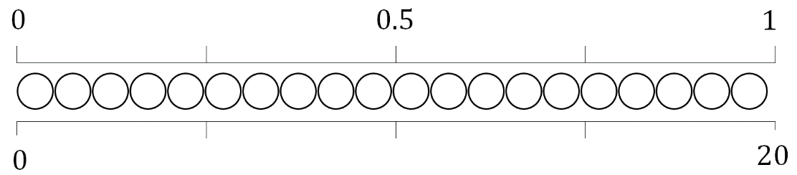
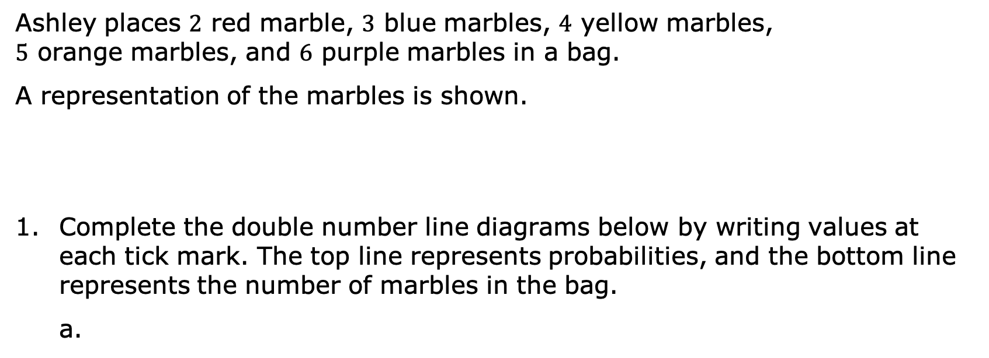
15.7.1 Warm-Up: Visualizing Probabilities
Ashley places $2$ red marble, $3$ blue marbles, $4$ yellow marbles, $5$ orange marbles, and $6$ purple marbles in a bag.
A representation of the marbles is shown.
Complete the double number line diagrams below by writing values at each tick mark. The top line represents probabilities, and the bottom line represents the number of marbles in the bag.
volume 2, pg. 432

Slide 7
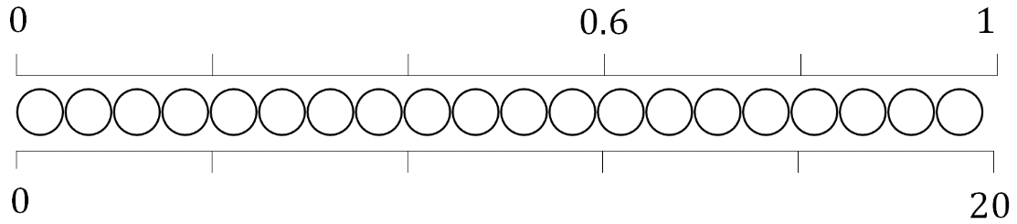
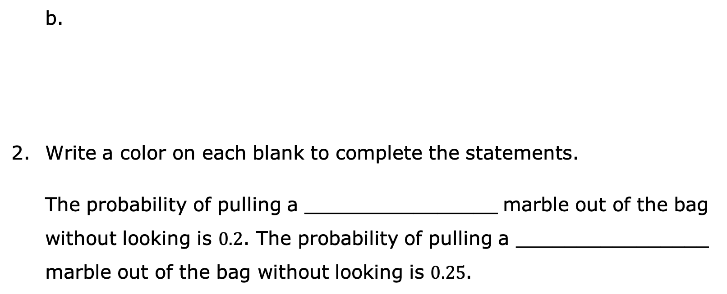
Write a color on each blank to complete the statements.
The probability of pulling a ________________ marble out of the bag without looking is $0.2$. The probability of pulling a ________________ marble out of the bag without looking is $0.25$.
volume 2, pg. 432

Slide 8

Collaboration
volume 2, pg. 432

Slide 9

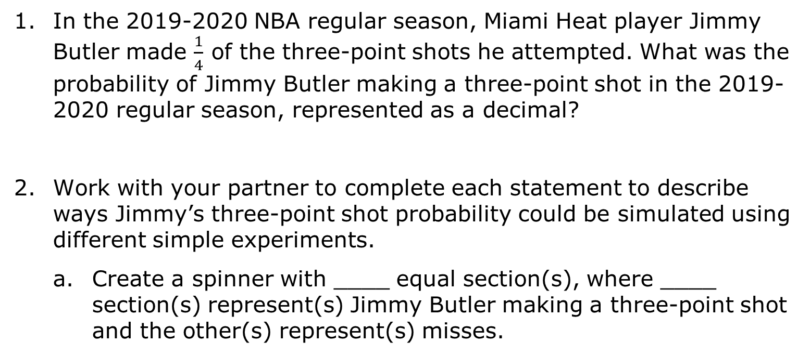
15.7.2 Collaboration: Simulating Probabilities
In the 2019-2020 NBA regular season, Miami Heat player Jimmy Butler made $\frac{1}{4}$ of the three-point shots he attempted. What was the probability of Jimmy Butler making a three-point shot in the 2019-2020 regular season, represented as a decimal?
Work with your partner to complete each statement to describe ways Jimmy’s three-point shot probability could be simulated using different simple experiments.
Create a spinner with ____ equal section(s), where ____ section(s) represent(s) Jimmy Butler making a three-point shot and the other(s) represent(s) misses.
volume 2, pg. 432

Slide 10
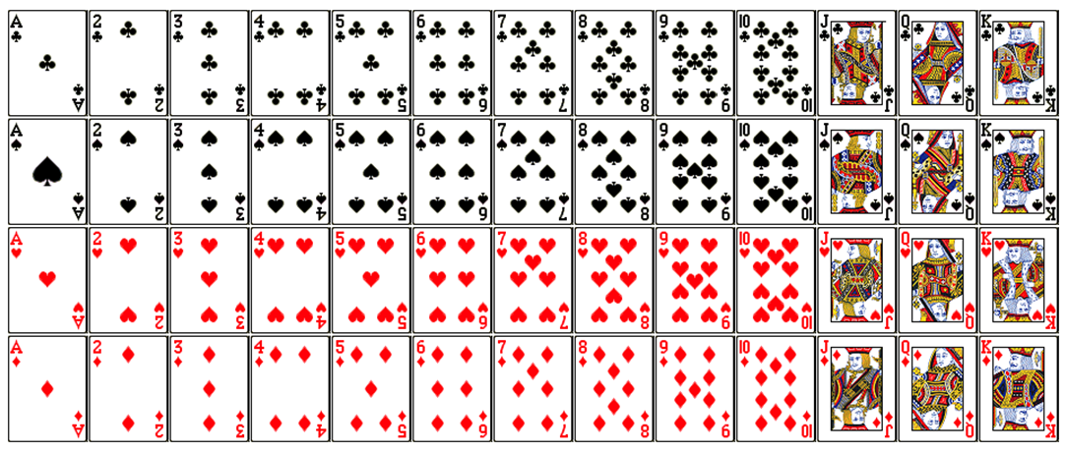
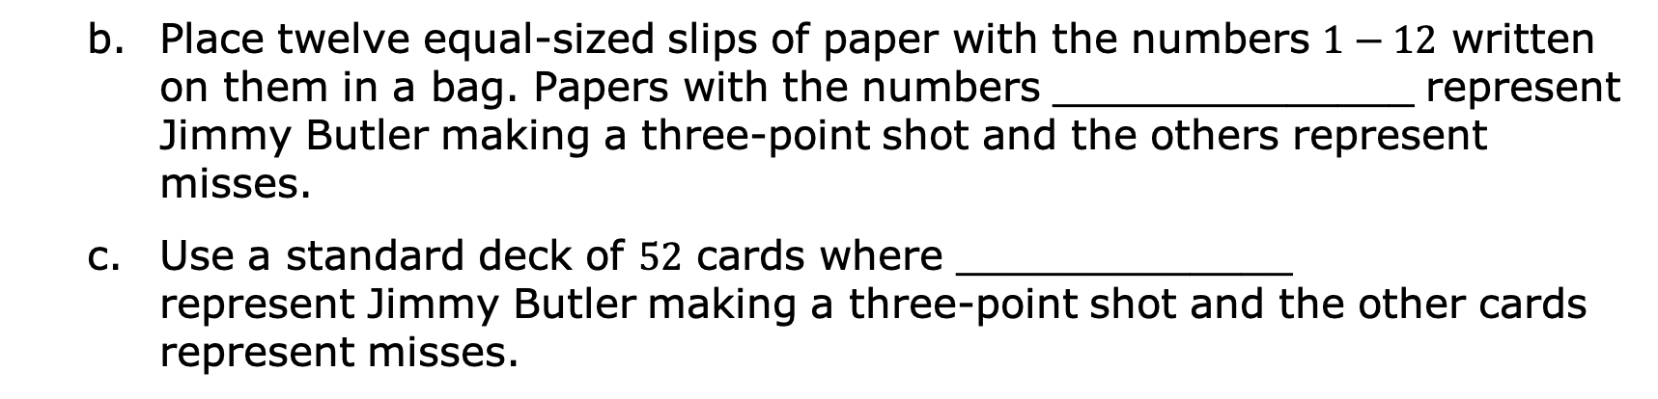
Place twelve equal-sized slips of paper with the numbers $1−12$ written on them in a bag. Papers with the numbers ______________ represent Jimmy Butler making a three-point shot and the others represent misses.
Use a standard deck of $52$ cards where _____________ represent Jimmy Butler making a three-point shot and the other cards represent misses.
volume 2, pg. 432

Slide 11
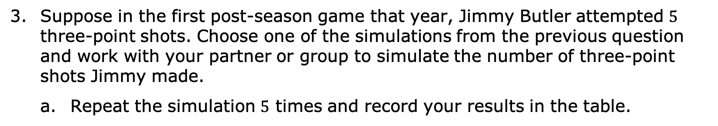
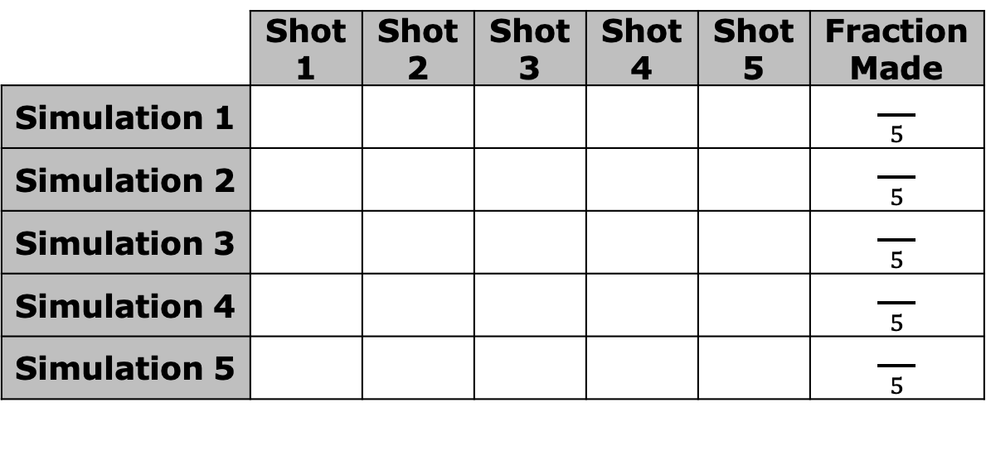
Suppose in the first post-season game that year, Jimmy Butler attempted $5$ three-point shots. Choose one of the simulations from the previous question and work with your partner or group to simulate the number of three-point shots Jimmy made.
Repeat the simulation $5$ times and record your results in the table.
 | Shot 1 | Shot 2 | Shot 3 | Shot 4 | Shot 5 | Fraction Made
Simulation 1 |  |  |  |  |  | $\frac{ }{ 5 }$
Simulation 2 |  |  |  |  |  | $\frac{ }{ 5 }$
Simulation 3 |  |  |  |  |  | $\frac{ }{ 5 }$
Simulation 4 |  |  |  |  |  | $\frac{ }{ 5 }$
Simulation 5 |  |  |  |  |  | $\frac{ }{ 5 }$
volume 2, pg. 433

Slide 12
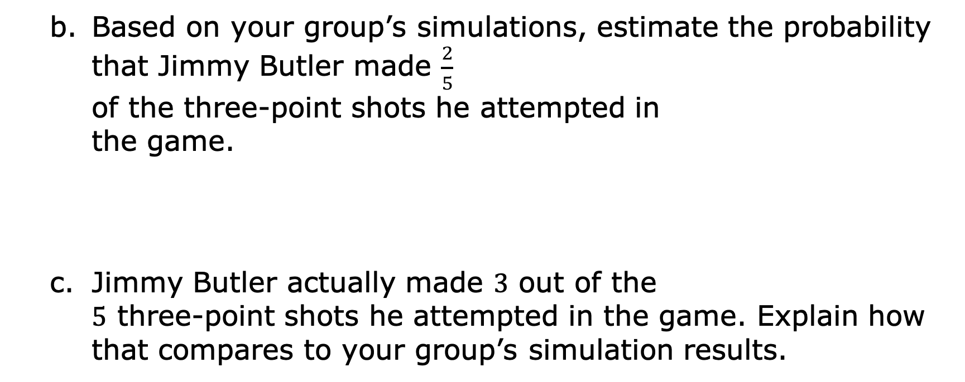
Based on your group’s simulations, estimate the probability that Jimmy Butler made $\frac{2}{5}$ of the three-point shots he attempted in the game.
Jimmy Butler actually made $3$ out of the $5$ three-point shots he attempted in the game. Explain how that compares to your group’s simulation results.
volume 2, pg. 433

Slide 13
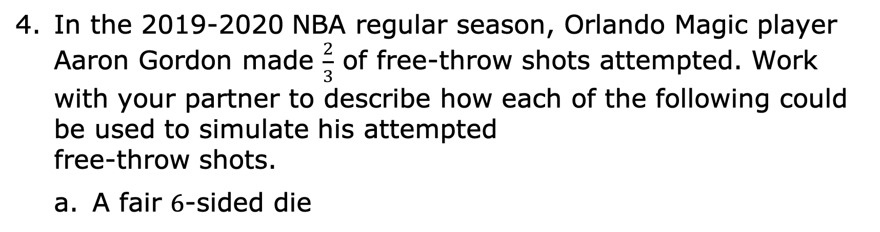
In the 2019-2020 NBA regular season, Orlando Magic player Aaron Gordon made $\frac{2}{3}$ of free-throw shots attempted. Work with your partner to describe how each of the following could be used to simulate his attempted free-throw shots.
A fair $6$-sided die
volume 2, pg. 433

Slide 14
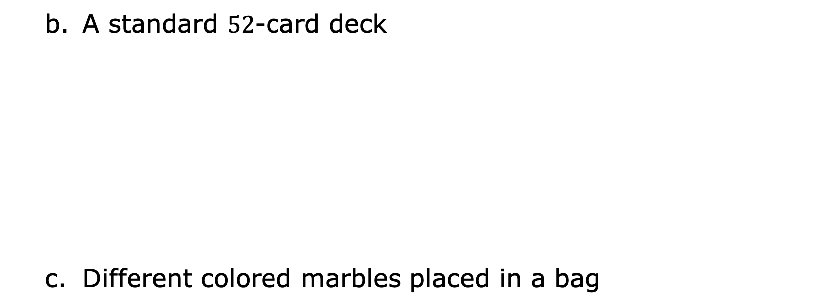
A standard $52$-card deck
Different colored marbles placed in a bag
volume 2, pg. 433

Slide 15

Your Turn
volume 2, pg. 434

Slide 16
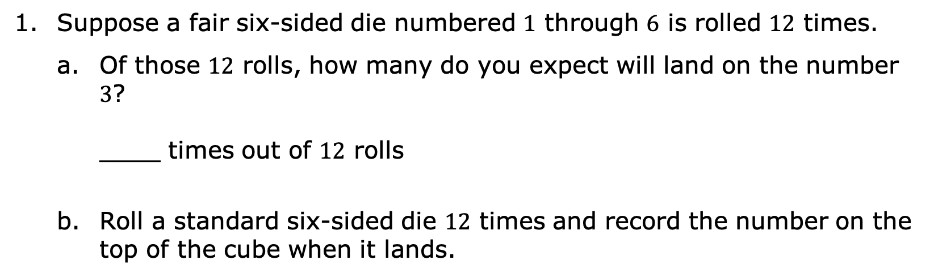
15.7.3 Your Turn!
Suppose a fair six-sided die numbered $1$ through $6$ is rolled $12$ times.
Of those $12$ rolls, how many do you expect will land on the number $3$? ____ times out of $12$ rolls
Roll a standard six-sided die $12$ times and record the number on the top of the cube when it lands.
Roll 1 | Roll 2 | Roll 3 | Roll 4 | Roll 5 | Roll 6 | Roll 7 | Roll 8 | Roll 9 | Roll 10 | Roll 11 | Roll 12
volume 2, pg. 434

Slide 17
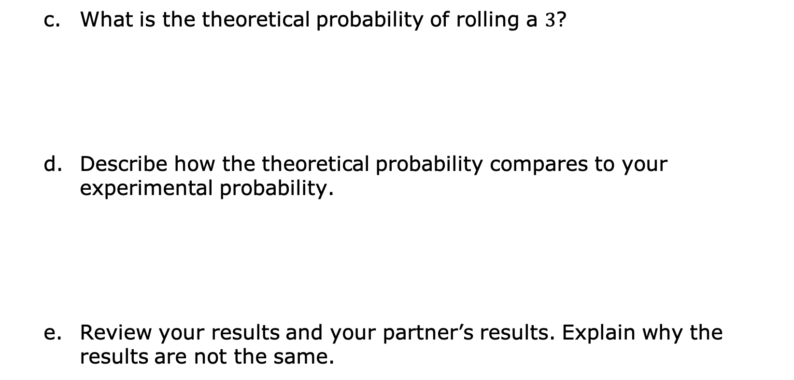
What is the theoretical probability of rolling a $3$?
Describe how the theoretical probability compares to your experimental probability.
Review your results and your partner’s results. Explain why the results are not the same.
volume 2, pg. 434

Slide 18
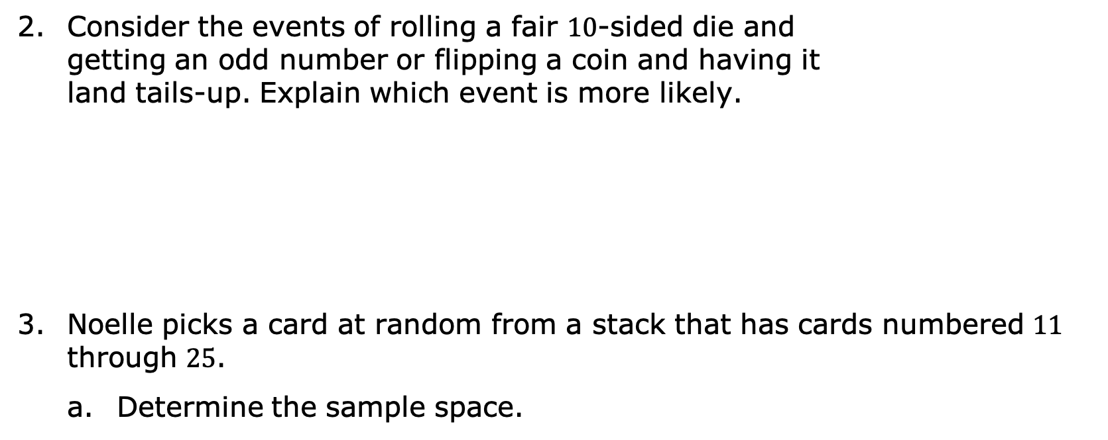
Consider the events of rolling a fair $10$-sided die and getting an odd number or flipping a coin and having it land tails-up. Explain which event is more likely.
Noelle picks a card at random from a stack that has cards numbered $11$ through $25$.
Determine the sample space.
volume 2, pg. 434

Slide 19
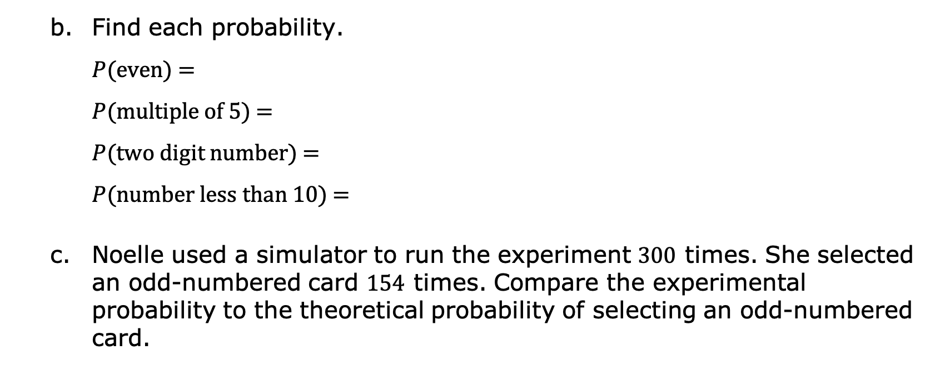
Find each probability. $P$(even) = $P$(multiple of 5) = $P$(two digit number) = $P$(number less than 10) =
Noelle used a simulator to run the experiment $300$ times. She selected an odd-numbered card $154$ times. Compare the experimental probability to the theoretical probability of selecting an odd-numbered card.
volume 2, pg. 434

Slide 20

Wrap-Up
volume 2, pg. 435

Slide 21
15.7.4 Wrap-Up: Reflection
In this unit, you have learned multiple concepts about probability, including those listed below.
Determine the sample space for a simple experiment
Rewrite rational numbers in different but equivalent forms
Interpret and compare the probability of chance events
Find the theoretical probability of an event related to a simple experiment
Compare experimental probability from simulations to theoretical probability
volume 2, pg. 435

Slide 22
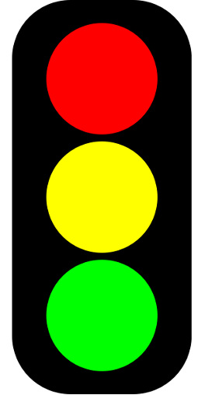
Use the stoplight reflection below to share how you are feeling about each of these concepts at this point.
I still feel stuck on how to … I’m starting to get the hang of … I feel confident and ready to go with …
volume 2, pg. 435

